Slide 1
Vehicle Detection and Classification
Group Number: 5
Group Name: MAVY
Mentor: Professor Mehul Raval
AU1940098: Manan Anjaria
AU1940145: Anar Bhagat
AU1940225: Vedanshee Trivedi
AU1940082: Yuvraj Patel

Slide 2
Problem Statement
Highways and roads are getting overcrowded due to rise in the number of vehicles aided by the lack of data for intelligent transportation management

Slide 3
Central idea- body of work
To develop automatic vehicle detector, classifier and counter that can be utilized for better traffic management
Use OpenCV for tracking and for better classification we use CNN
Create a database post detection to count and classify the vehicles that can help in traffic management

Slide 4
Your approach
Vehicle detection and classification using OpenCV
Used YOLOv3 model trained with coco dataset with OpenCV
YOLO works using –
Residual Blocks
Bounding Box Regression
Intersection Over Union

Slide 5
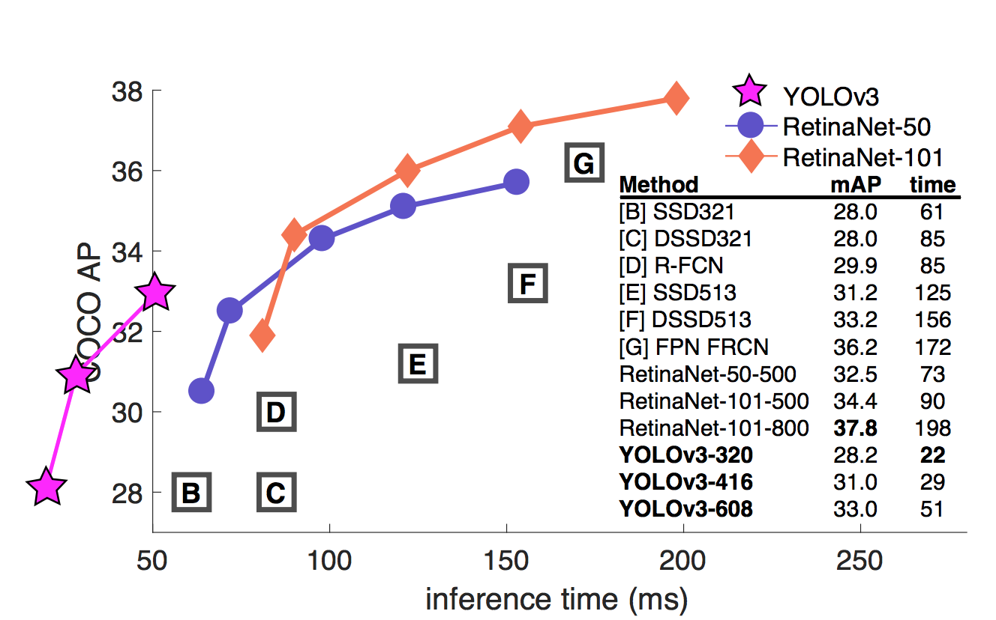
Why YOLO V3?
YOLO v3 is much more accurate in identifying smaller object and in our case while taking the top view of cars from distance they appear much smaller.
It is much more faster than the nearest competitor
References:Redmon, J., & Farhadi, A. (2018). Yolov3: An incremental improvement. arXiv preprint arXiv:1804.02767.

Slide 6
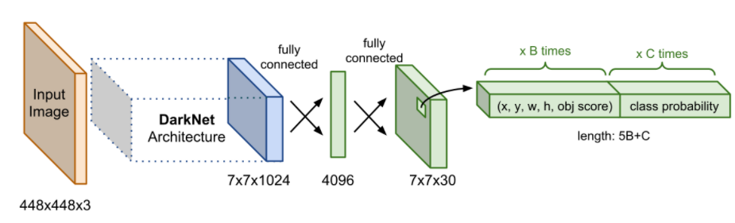
YOLO Architecture
References:Weng, L. (2018, December 27). Object detection part 4: Fast detection models. Lil'Log (Alt + H). Retrieved March 27, 2022, from https://lilianweng.github.io/posts/2018-12-27-object-recognition-part-4/

Slide 7
About the dataset?
We have used the MS COCO dataset for training
It Free of cost and widely used
The MS COCO dataset is a large-scale object detection, segmentation, and captioning dataset published by Microsoft.
The classes used are as follows
Car
Truck
Motorcycle
Bus
It Free of cost and widely used
References:Lin, T. Y., Maire, M., Belongie, S., Hays, J., Perona, P., Ramanan, D., ... & Zitnick, C. L. (2014, September). Microsoft coco: Common objects in context. In European conference on computer vision (pp. 740-755). Springer, Cham.

Slide 8
Your Approach
Read image at a location
Pre-process image for detection
Post process the output
Counting of vehicles
Classify the different vehicles only if the confidence level is above 20% (accuracy at confidence level 20% is 85%)

Slide 9
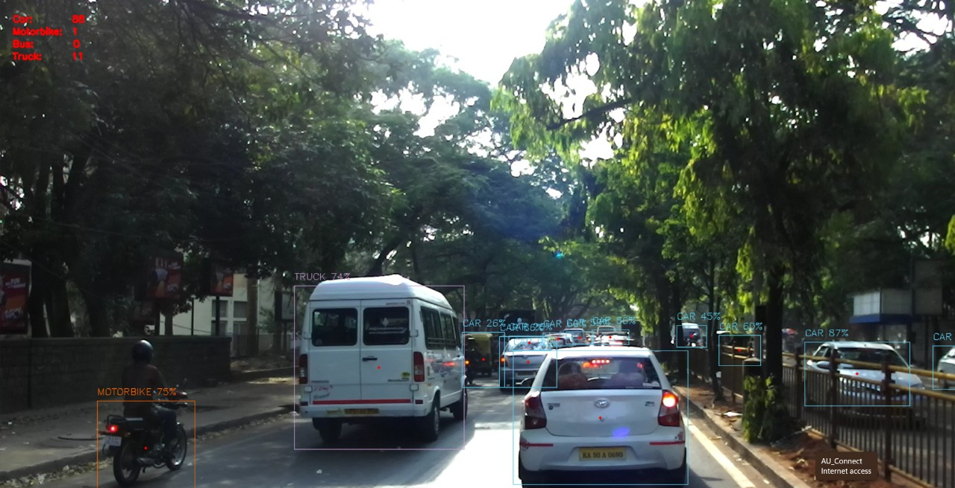
Initial Results

Slide 10
Future Work
Read frames from a video file instead of image
Tracking of vehicles
Pre-process the frame and run detection
Finding the optimum confidence threshold.
Post process the output
Count all the vehicles on road and the direction they move in with respect to the centerline in the Video
Save the data to CSV file

Slide 11
Contribution of Group Members
Name | Contribution
Vedanshee Trivedi | PPT, Vehicle tracking coding
Yuvraj Patel | Report, Vehicle classification coding, Problem formulation
Manan Anjaria | Coding and execution on real world dataset
Anar Bhagat | Report, Vehicle tracking coding

Slide 12
References
https://techvidvan.com/tutorials/opencv-vehicle-detection-classification-counting/
https://medium.com/@artinte7/real-time-object-detection-using-yolo-upon-google-colab-in-5-minutes-fd65a4903df5
https://www.analyticsvidhya.com/blog/2021/12/vehicle-detection-and-counting-system-using-opencv/
https://lilianweng.github.io/posts/2018-12-27-object-recognition-part-4/

